Slide 1
Body fitness prediction
Using machine learning
SmartBridge- remote internship program
developed by
Jyoshna kondaparthi
Madhukar revuri
Eshwar rangu
kumaraswamy

Slide 2
Synopsis
Introduction
How to improve Body fitness
Importance of body fitness
Benifits

Slide 3
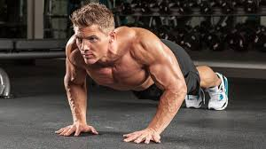
Introduction
Body fitness is a State of health and being and, more specifically,the ability to perform aspects of sports, occupations and daily activities.
Body fitness is achieved through proper nutrition, physical exercise,and sufficient rest.

Slide 4
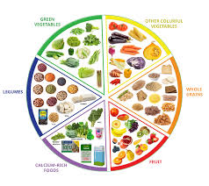
How to improve body fitness
Exercise daily. Exercise daily for at least an hour.
Eat the right food and portion each meal.
Keep track of calories and food intake per day.
Be sure to get sleep

Slide 5
Importance of Body fitness
Regular exercise and physical activity promotes strong muscles and bones.
It improves respiratory,and overall health.
Staying active can also help you maintain a healthy weight, reduce your risk of diabetes, heart disease,and reduce your risk for some cancers.

Slide 6
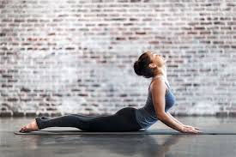
Benefits
Reduce your risk of a heart attack
Manage your weight better
Have a lower blood Chlorestrol level
Have lower blood pressure
Have stronger bones
Lower risks of diabetes and some cancers

Slide 7
Thank you

